Slide 1
Test Automation
ZL Chen, SIoT DQA, Advantech

Slide 2
Agenda
What is Test Automation?
What is the Test Automation Pyramid?
What is difference between Test Automation and Automation Testing?
Automation Testing Tools for Introduction & Demo

Slide 3
What is Test Automation?
In software testing, test automation is the use of software separate from the software being tested to control the execution of tests and the comparison of actual outcomes with predicted outcomes.
Test automation can automate some repetitive but necessary tasks in a formalized testing process already in place, or perform additional testing that would be difficult to do manually. Test automation is critical for continuous delivery and continuous testing.
Notes:
軟體測試當中，自動化測試是利用軟體控制代測物上的行為上的測試並且去互相比較實際上與預期上的結果。
測試自動化是自動執行重複性且必要的的一個任務且比較難用手動的方式去呈現。
所以自動化測試是會持續交付與持續測試來說是非常重要的。

Slide 4
Why ???
Why Automation Needs Humans?
Why Automation?
Why Automation is NOT easy?
Why Automation Testing is important?

Slide 5
Why Automated Testing?
Automated testing is important due to following reasons:
Time and cost consuming.
Testing for multilingual sites manually.
Automation does not require human intervention.
Automation increases speed of test execution & test coverage.
Manual testing can become boring and hence error prone.
Notes:
Automation does not require human intervention.
- You can run automated test unattended (overnight).

Slide 6
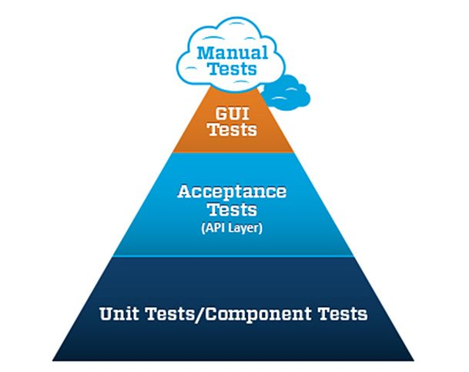
What is Test Automation Pyramid?
There are many approaches to test automation, however below are the general approaches used widely:
Graphical user interface testing
API driven testing
Unit testing

Slide 7
What is difference between Test Automation and Automation Testing?
Automated testing is the act of conducting specific tests via automation as opposed to conducting them manually. Just like a set of regression tests.
Test automation refers to automating the process of tracking and managing the different tests.
Notes:
自動化測試就像利用自動化執行手動測試的行為，像是自動化的回歸測試。
測試自動化是一個測試流程的缺陷管理測試。

Slide 8
Automation Testing Tools for Introduction & Demo
Roaming automation
Wi-Fi frequency switch automation (2.4G, 5G)
Airplane on/off mode automation
Android 6.0.1 (RJ-45) or Android 8.0.1 (RJ-45) for WLAN and WWAN
Android 6.0.1 (OTG) or Android 8.0.1 (OTG) for WLAN and WWAN
Windows for WLAN
Resolution automation
Luminance automation
PXE automatic installation
BurnInTest automation
ProgramIndex automation
Continuous Integration

Slide 9
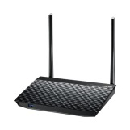
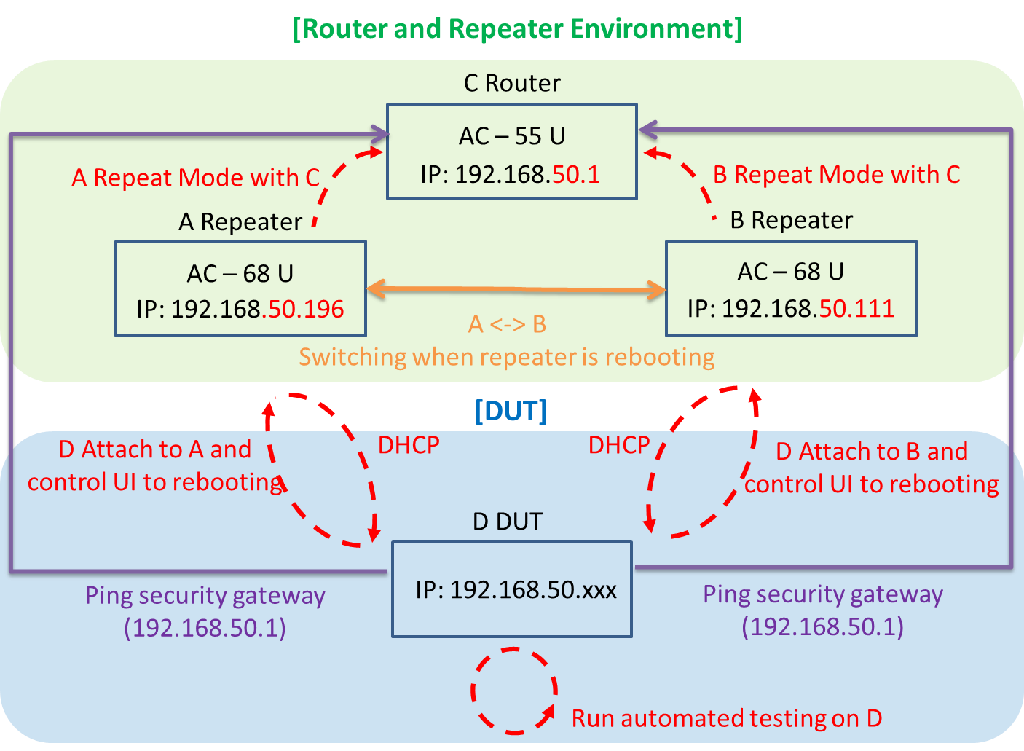
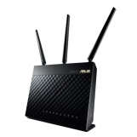
Roaming automation
System Structure

Slide 10
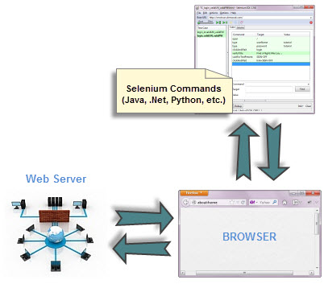
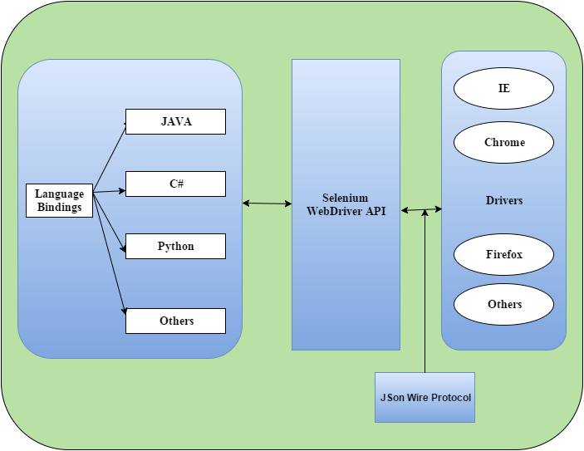
Roaming automation – Selenium Web driver
Selenium’s web driver application and infrastructure

Slide 11
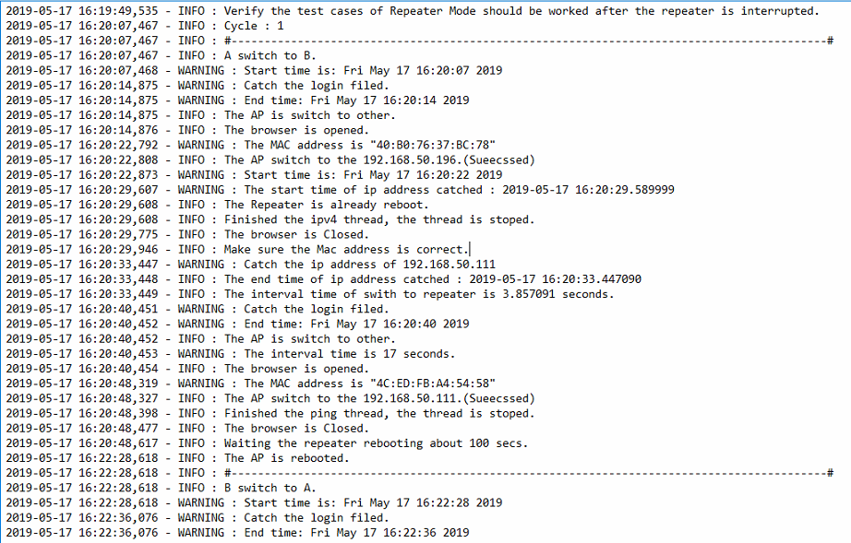
Roaming automation
The roaming’s log is as below:

Slide 12
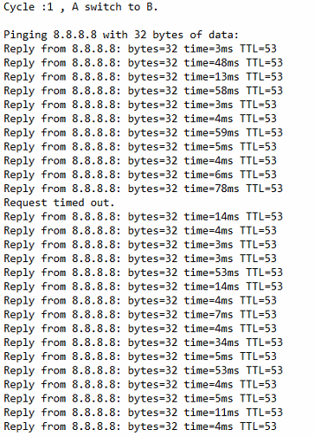
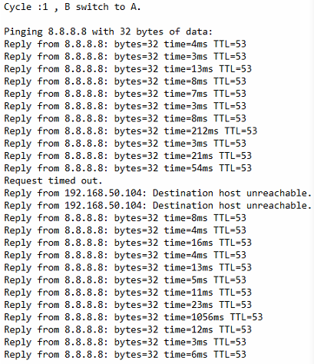
Roaming automation
The roaming’s ping log are as below:

Slide 13
Roaming automation
Solution
Reduce the manual testing errors.
In order to switch the AP process.
Accurately to capture the ping logs.
Execute the long-term load testing.
Notes:
解決方案
減少手動測試失誤問題
省去手動切換 AP 行為
準確擷取 Ping 紀錄檔
長時間壓力測試執行

Slide 14
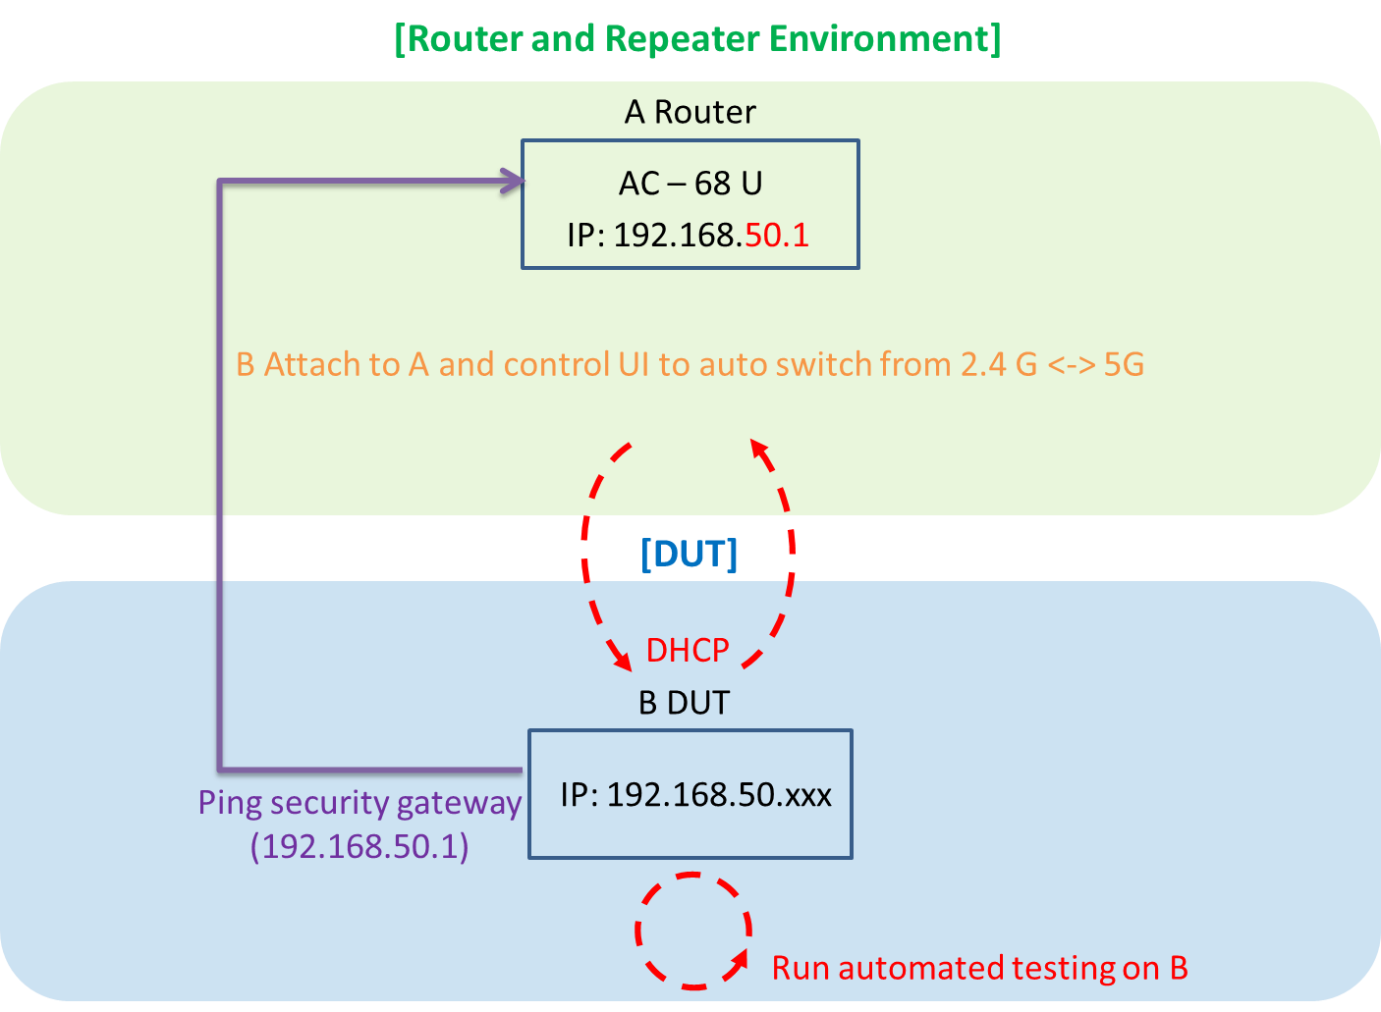
Wi-Fi frequency switch automation (2.4G, 5G)
System Structure

Slide 15
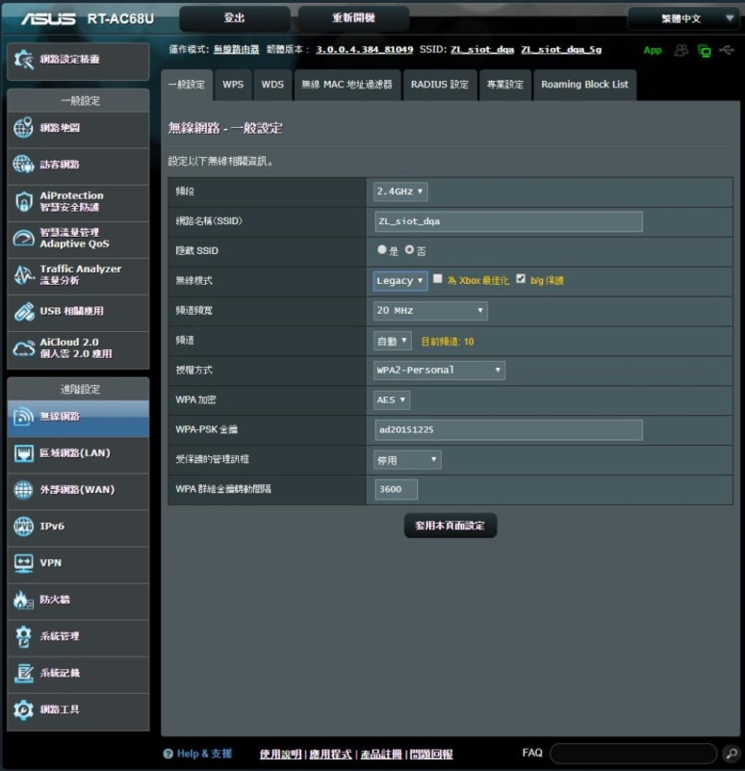
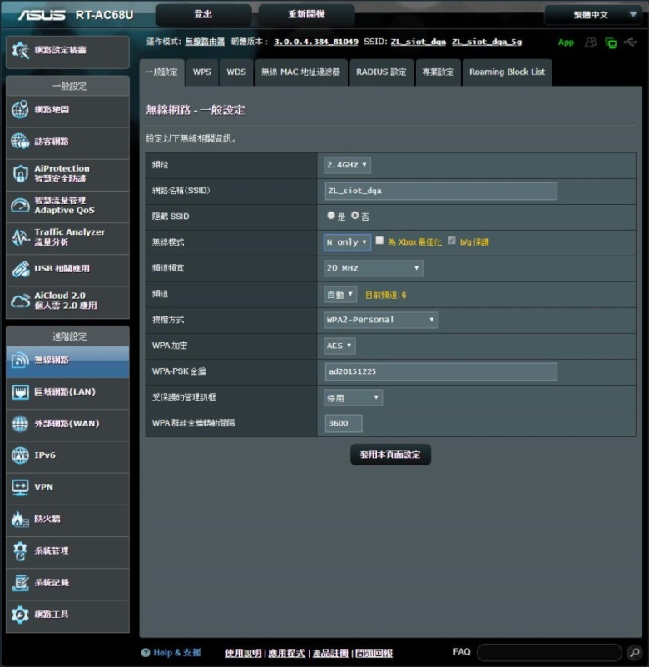
Wi-Fi frequency switch automation (2.4G, 5G)
The Wi-Fi switch’s screenshot and log are as below:

Slide 16
Wi-Fi frequency switch automation (2.4G, 5G)
Solution
In order to fine-tune the switch function of the [N Only] and [Legacy] based on Wi-Fi AP switch of 2.4G.
In order to fine-tune the switch function of the [N/AC mixed] and [Legacy] based on Wi-Fi AP switch of 5G.
Load testing of 2.4G and 5G.
Notes:
解決方案
針對 Wi-Fi Mode 中的 2.4 G 中的 N Only, Legacy 相互切換
針對 Wi-Fi Mode 中的 5 G 中的 N/AC mixed, Legacy 相互切換
長時間做 2.4 G 及 5 G 之壓力測試

Slide 17
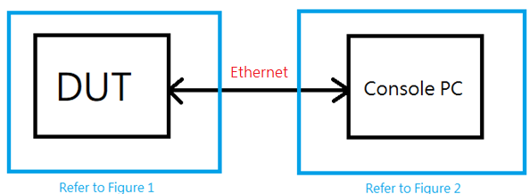
Airplane on/off mode automation (Androd)
Android 6.0.1 (RJ-45) or Android 8.0.1 (RJ-45) for WLAN and WWAN
Block Diagram

Slide 18
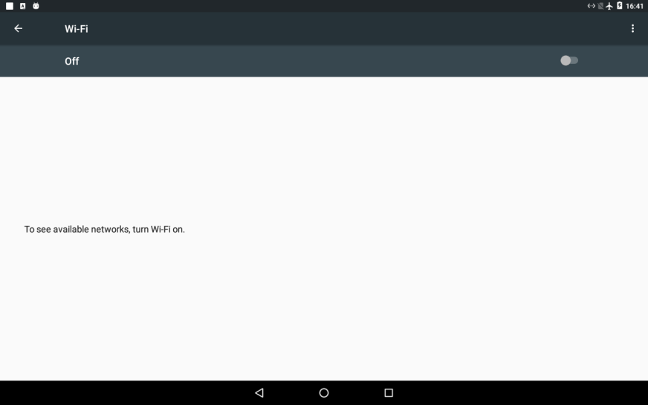
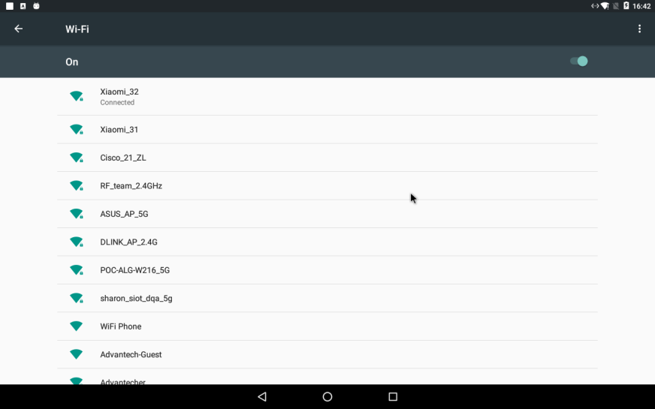
Airplane on/off mode automation
The output screenshot and log are as below:
Airplane on (wifi off) Airplane off

Slide 19
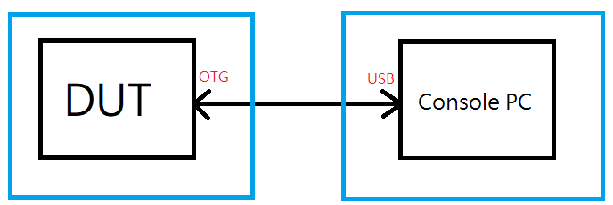
Airplane on/off mode automation (Android, OTG)
Android 6.0.1 or Android 8.0.1 (OTG) for WLAN and WWAN
Block Diagram

Slide 20
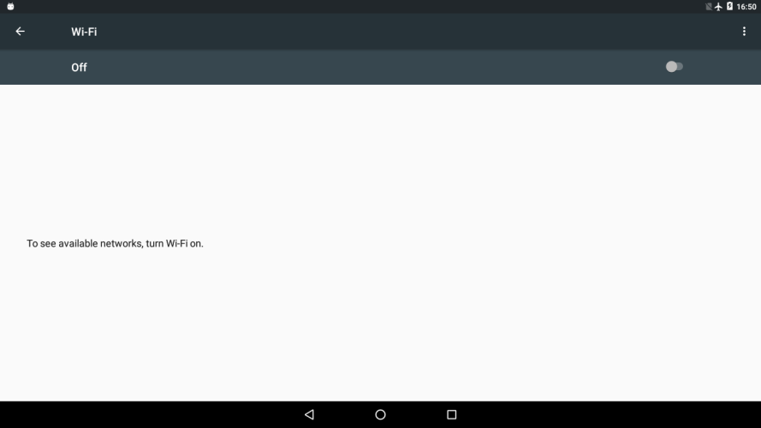
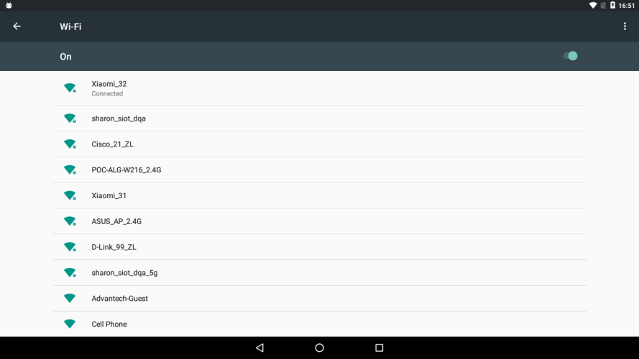
Airplane on/off mode automation
The output screenshot and log as below:
Airplane on () Airplane off

Slide 21
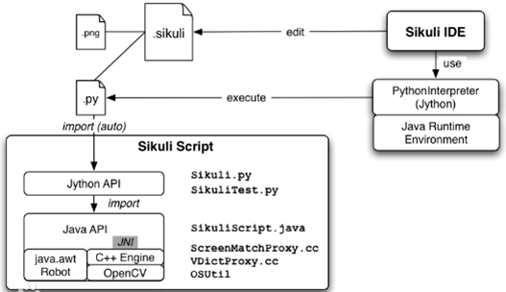
Airplane on/off mode automation
Windows for WLAN
The test script base on Sikuli API under the windows environment.
Base on Python with Java environment
How Sikuli works ?
airplane_mode_on.sikuli
airplane_mode_on.py
airplane_mode_off.sikuli
airplane_mode_off.py

Slide 22
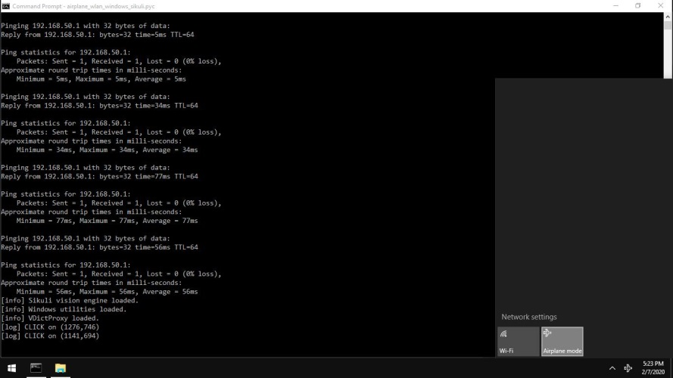
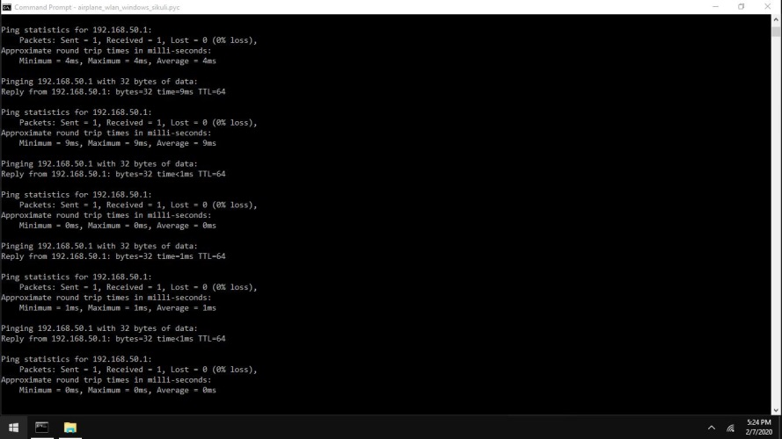
Airplane on/off mode automation (window)
The output screenshot and log as below:
Airplane on Airplane off

Slide 23
Airplane on/off mode automation
Solution
Finish the airplane switch on/off mode stability by load testing.
#The classification are as below:
#The WLAN or WWAN automated testing by RJ-45 in Android 6.0.
#The WLAN or WWAN automated testing by RJ-45 in Android 8.0.
#The WLAN or WWAN automated testing by OTG in Android 6.0.
#The WLAN or WWAN automated testing by OTG in Android 8.0.
#The WLAN automated testing in Windows.
Notes:
解決方案
長時間壓力下且能完成飛航模式開關的穩定性
大致區分為以下五種：
透過 RJ-45 做 Android 6.0 系統中的 WLAN 或 WWAN 壓力測試
透過 RJ-45 做 Android 8.0 系統中的 WLAN 或 WWAN 壓力測試
透過 OTG 做 Android 6.0 系統中的 WLAN 或 WWAN 壓力測試
透過 OTG 做 Android 8.0 系統中的 WLAN 或 WWAN 壓力測試
Windows 系統中的 WLAN 壓力測試

Slide 24
Resolution automation
The Tool base on the GPU resolution
Auto catch the resolution by batch code
Auto catch the resolution by batch code. (Reboot)
Solution:
Automatically capture the GPU resolution of the host/mainframe with auto testing process.
Reboot with long period to capture resolution.
Notes:
解決方案
透過程式自動擷取主機 GPU 解析度
長時間重開機解析度擷取

Slide 25
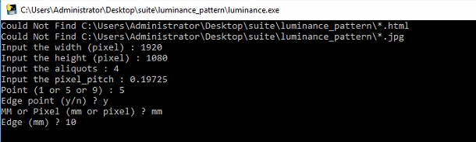
Luminance automation
The tool of pre-conditions base on the product specification.
Width
Height
Aliquots
Pixel Pitch
Point
Edge

Slide 26


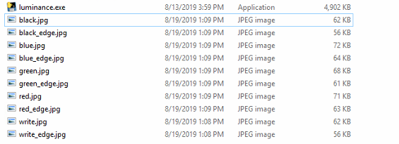


Luminance automation
The output luminance photo.

Slide 27
Luminance automation
Solution
Develop a production program according to the product requirements and spec.
Fast generate picture and write program to measure the panel.
Notes:
解決方案
依產品需求規格製作產圖之程式
方便內部人員快速產圖並做量測 Panel 之程式

Slide 28
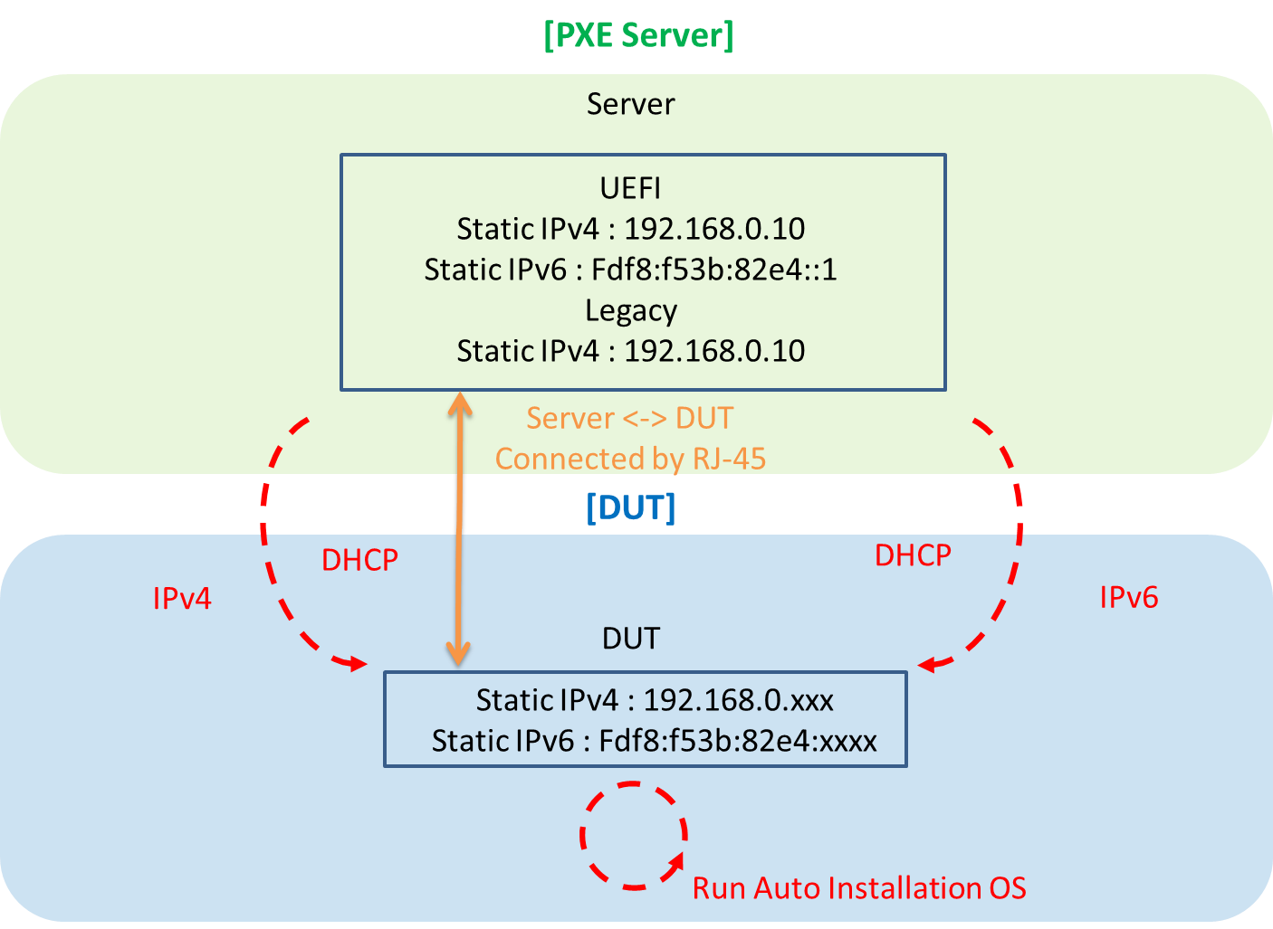
PXE automatic installation
System Structure

Slide 29
PXE automatic installation
#Operation System
#Windows Server 2012 R2 for Legacy 32 bits
#Windows Server 2012 R2 for Legacy 64 bits
#Windows Server 2012 R2 for UEFI 64 bits
Solution
Automatic process/procedure installing the Windows OS.
Load testing of long-term automatically install.
Notes:
解決方案
自動化安裝 Windows OS 程序
長時間自動安裝壓力測試

Slide 30
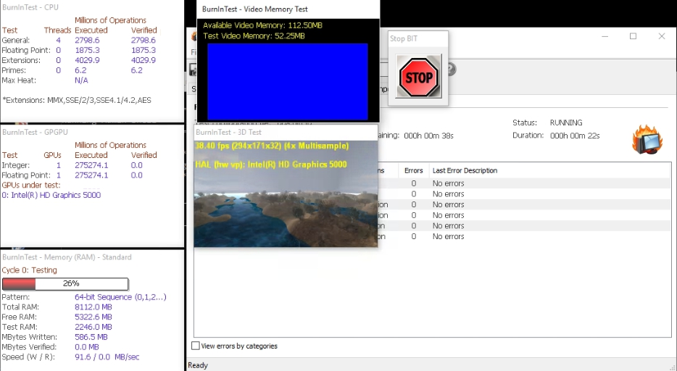
#BurnInTest automation
##The tool of pre-conditions base on the exe script.
Notes:
bit.exe -c dqa.bitcfg -r -p -D “minutes”

Slide 31
#BurnInTest automation
#Solution:
Long-time load testing through Bash Script under BurnlnTest..
Automatically generate and backup the log file.
Notes:
解決方案
透過 BurnInTest 的 Bash Script 做長時間壓力測試
自動產生及備份 Log 檔案

Slide 32
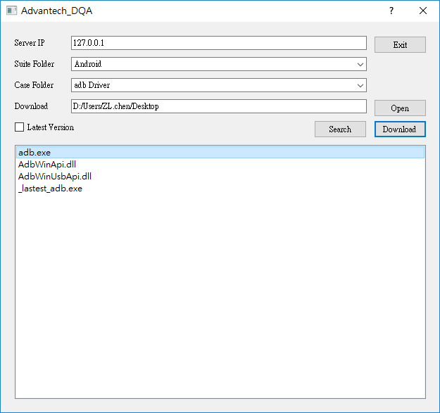
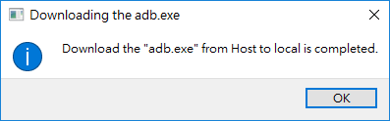
ProgramIndex automation
Download the file by ProgramIndex user interface.
Server IP
Suite Folder
Case Folder
Downlod

Slide 33
ProgramIndex automation
Solution
Download corresponding programs using ProgramIndex.
Extract data/files on FTP Server and download right away.
Notes:
解決方案
透過 ProgramIndex 程式方便下載相對應程式
可以直接抓取 FTP 上的資料直接下載

Slide 34
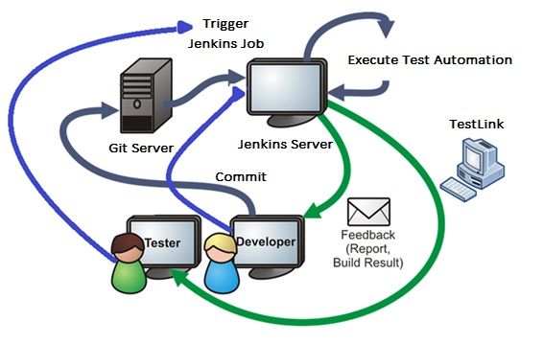
Continuous Integration
System Structure

Slide 35
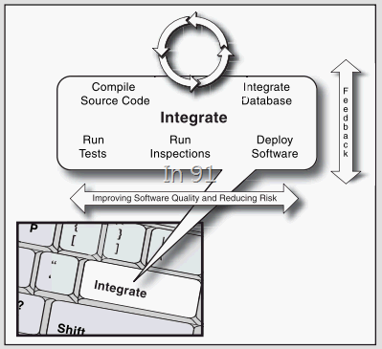
Continuous Integration
CI is as natural as the Enter key on the keyboard. In every change, the CI server helps us integrate all relevant services and feeds the results back to the entire team, just like a doctor is helping the system to be healthy all the time to examination.
Conclusion
Auto build source code
Automated Testing
Code analysis
Automatic deployment
Database integration

Slide 36
#Hyperlink
#Main:
\\172.17.9.225\dqa\iService\0G.DQA_Zone\50.Auto Test Tool\automation\
#Installer:
\\172.17.9.225\dqa\iService\0G.DQA_Zone\50.Auto Test Tool\automation\installer\
#Test Tools:
\\172.17.9.225\dqa\iService\0G.DQA_Zone\50.Auto Test Tool\automation\suite\
#Standard Operation Procedure :
\\172.17.9.225\dqa\iService\0G.DQA_Zone\50.Auto Test Tool\automation\sop\

Slide 37
Go Together,
We Go Far and Grow Big

